Slide 1
Muslims, Jews and Keeping Healthy During the Covid-19 Crisis Dr Jackie Rose 26th April 2020

Slide 2
Co-Author of ‘To Life! Healthy Jewish Food’

Slide 3
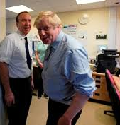
Boris Johnson vs Matt Hancock
Size does matter when it comes to immunity to Covid-19 or resilience to infection.
(Photograph from the Telegraph on-line)

Slide 4
Don’t delay – “Getting fit and shedding fat” to fight off the Corona virus. -Your life could depend on it. (Times Newspaper)

Slide 5
Some Techniques to Lose Weight and Prevent Diabetes
CUT OUT SUGAR
SQUEEZE OUT THE CARBS ON YOUR PLATE
MORE FIBRE
INTERMITTENT FASTING OR TIME-RESTRICTED EATING
WATCH PORTION SIZES
CUT OUT ALL JUNK FOOD AND SODAS/FRUIT JUICES. REDUCE ALCOHOL.
FERMENTED FOODS
FRUIT AND VEG, GREEN TEA AND NUTS
EXERCISE

Slide 6
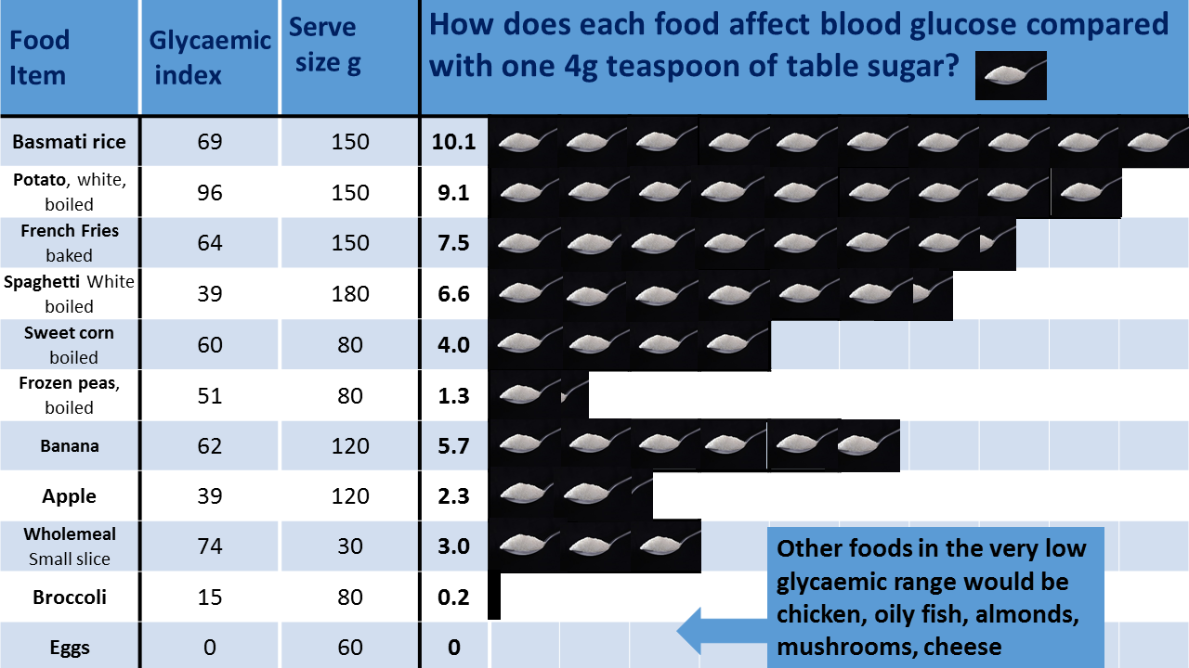

Slide 7
SWAPS
White rice Brown rice with lentils (Mujadarra), quinoa or cauliflower rice
Bagels or bread Oatcakes or small chapatti or omit
Potatoes Sweet potatoes (small)
Chutney Raita
Sweets Berries or cherry tomatoes or 70%+ plain chocolate
Toast or cereal Eggs
Poppadoms, crisps or Bombay mix Nuts or olives
Pakoras or chips Spiced oven-roasted veg
Desserts Fresh fruit
Sugar Nothing or Stevia / Erythritol

Slide 8
DON’T HAVE A ‘BREAD BASED DIET’
It’s the sugar and carbs that do the most damage to your waist line.

Slide 9
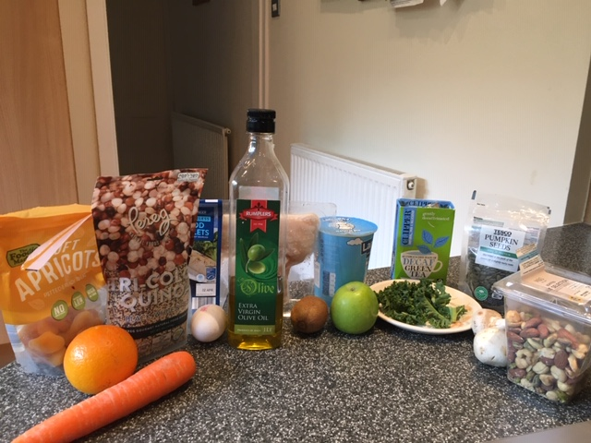
WHOLE FOOD IMMUNITY BOOSTERS
Providing vitamins A, B2, B6, B12, D, C, E,
Folic acid, Iron, Selenium, Ai
Zinc and Protein

Slide 10
A HEALTHY RAMADAN
Drink plenty of water with Suhoor and Iftar meals
Make Suhoor the larger meal and keep Iftar ‘light’
High Fibre e.g. brown rice or quinoa
More Protein- ideally grilled or baked
Plentiful Vegetables
Minimise sweet foods- including dates
Don’t fast if Diabetes or Other Chronic health conditions
Front Line workers to consider whether they are able to safely fast or break their sleep for early morning prayers.

Slide 11
Keep On Keeping Safe and Well!

